Slide 1
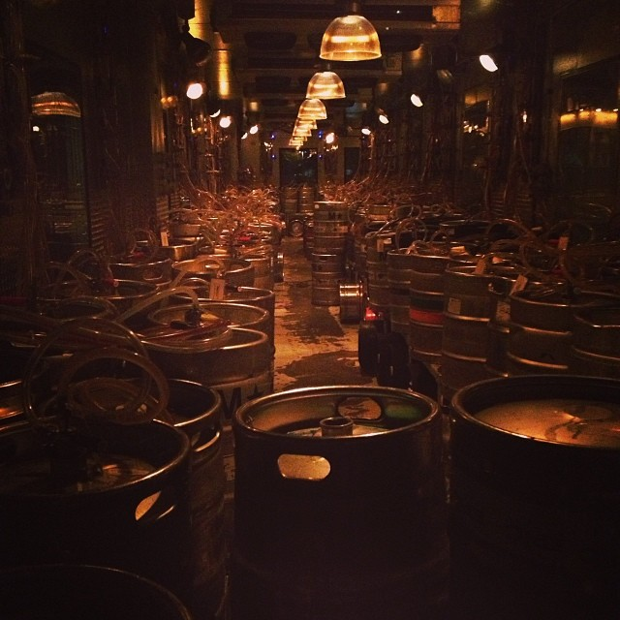
Keggers aka Kegs “R” Us
Team 2:
Fola, Pablo, Phani, Frank, and Peter
Notes:
General Idea
Market
Analysis of Competitors
Competitive Advantage
Risk Analysis & Business Challenges
Proposed plan of action
Timeline of the Project & Technological Challenges

Slide 2
Keggers: General Idea
What Do We Do?
Access to pickup/reserve kegs based on user feedback
How Do We Do It?
Liquor store owners have subscriptions for spots on the website
Business Model?
B2C (Vortal: Kegs)
Revenue?
Subscription Model
Notes:
Current ways of finding kegs involves manual work: searching online, reading through static lists, and calling locations.
Web app will accumulate partner data in one place, enable searches based on user criteria
Since we are a startup, we will contact locations about our web application and ask if they want to participate into a free trial. Our goal is that they will see an increase in sales from kegs specifically which will incentivize locations to sign up for a subscription
Our Business Model is Business to Consumer (more specifically it is a vertical portal that specializes in kegs), niche market
As said previously, our main revenue stream will be liquor store subscriptions

Slide 3
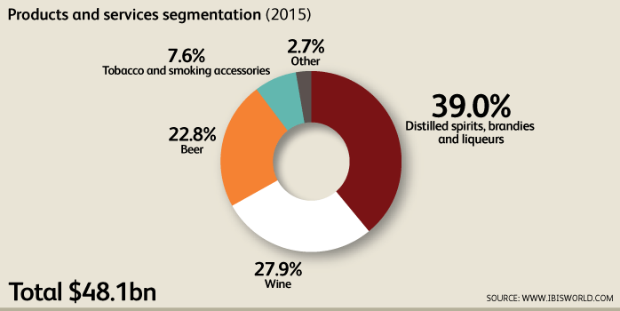
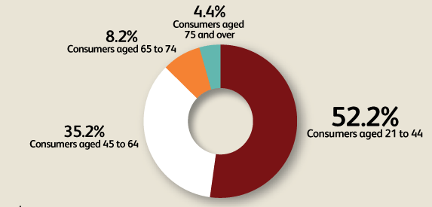
Market
Notes:
We are targeting both consumers and sellers of beer.
Beer makes up 22.8% of the alcoholic beverages market.
Since the Great Recession started, per capita income has improved. This indicates that consumers are more willing to spend money on alcohol.
Additionally, there has been a decline, among consumers, in health concerns. This is good for the industry, since alcohol is generally attributed to unhealthy lifestyles.
From 2010 to 2020, the population of those who are of drinking age is projected to grow at an annual rate of 9.4%.
Competition for our target markeis projected to increase as deregulation increases. Supermarkets and non-traditional retailers will be able to sell alcohol.
However, concentration in the market will be low. Monopolies are very unlikely to form because of deregulation.
States are very unlikely to allow cross border ownership of stores. Instead operators are more likely to concentrate in developing locally and maintaining a strong customer base through ads and marketing.
Since most liquor stores are owned independently, they lack a modern online presence.

Slide 4
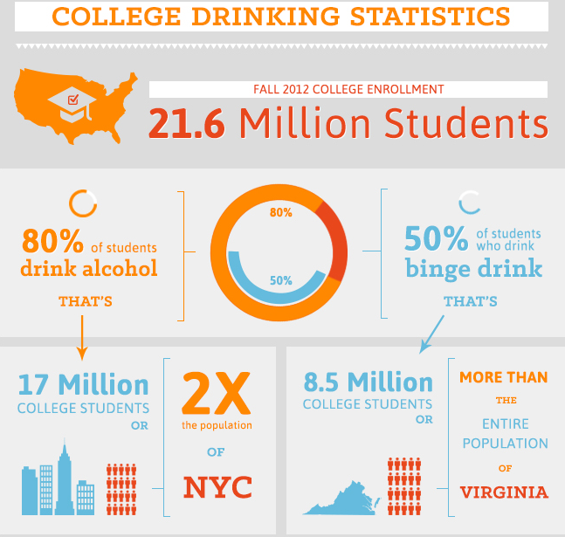
Market
Notes:
The first market we target will be college students.
As they have proven to be consistent customers.
There is an online industry with different facts, but we are not in this industry because we do not sell our own inventory But to make the point that college aged students are looking online for alcohol I present the following fact: The online alcohol market is about 743.2 million dollars a year, and
Consumers aged 21 to 25 comprise a small proportion of the total drinking population, but this market segment generates a large portion of industry revenue. In 2015, this market segment is expected to account for 27.1% of industry revenue, due to this demographics' significant exposure to technology and digital media. IBISWorld expects that this market is growing rapidly, as consumers in this age demographic are typically low-income earners who are looking to save on liquor through online sales and bulk purchases.
We rely on web/app services to get things done.
We will create an intuitive service for this age group.

Slide 5
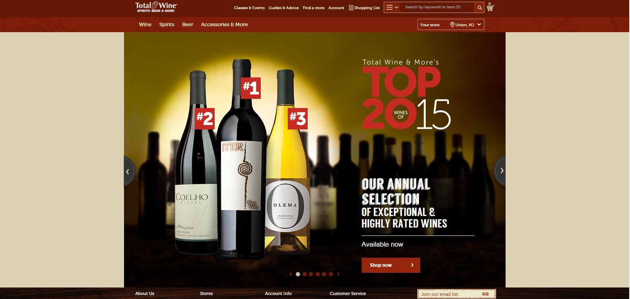
Analysis of Competitors
Notes:
TotalWine.com
Company’s 2014 revenue estimated to be more than $1.5 billion
113 stores in 16 different states:
Arizona, California, Connecticut, Delaware, Florida, Georgia, Maryland, Minnesota, Nevada, New Jersey, New Mexico, North Carolina, South Carolina, Texas, Virginia and Washington
Offers online Keg orders/reservations for in-store pick up at any of their locations
Data gathered from sources: www.totalwine.com
https://en.wikipedia.org/wiki/Total_Wine_%26_More

Slide 6
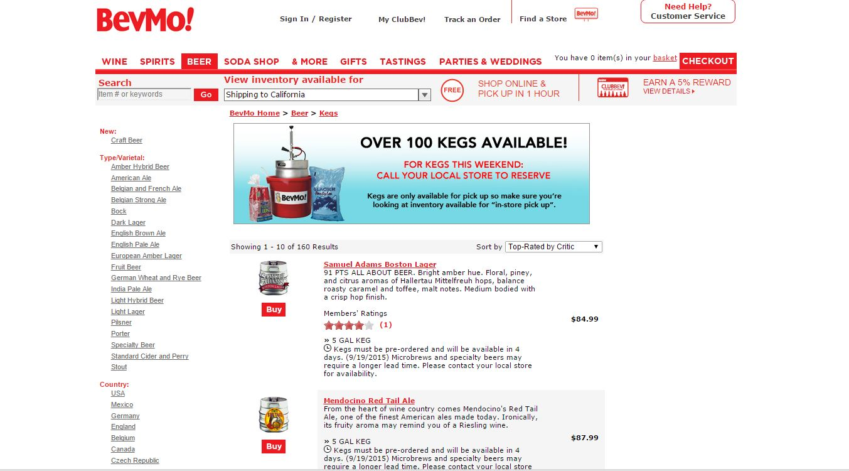
Analysis of Competitors
Notes:
BevMo!.com
Company’s revenue was estimated to be more than $500 million as of September 2009
148 stores in 3 different states:
Arizona, California, and Washington
Offers online orders/reservations for in-store pick up at any of their locations in the 3 states
Also offers shipping of kegs within the 3 states
Data gathered from sources: www.bevmo.com
https://en.wikipedia.org/wiki/BevMo!

Slide 7


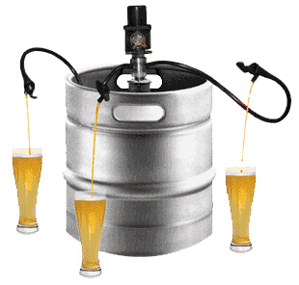
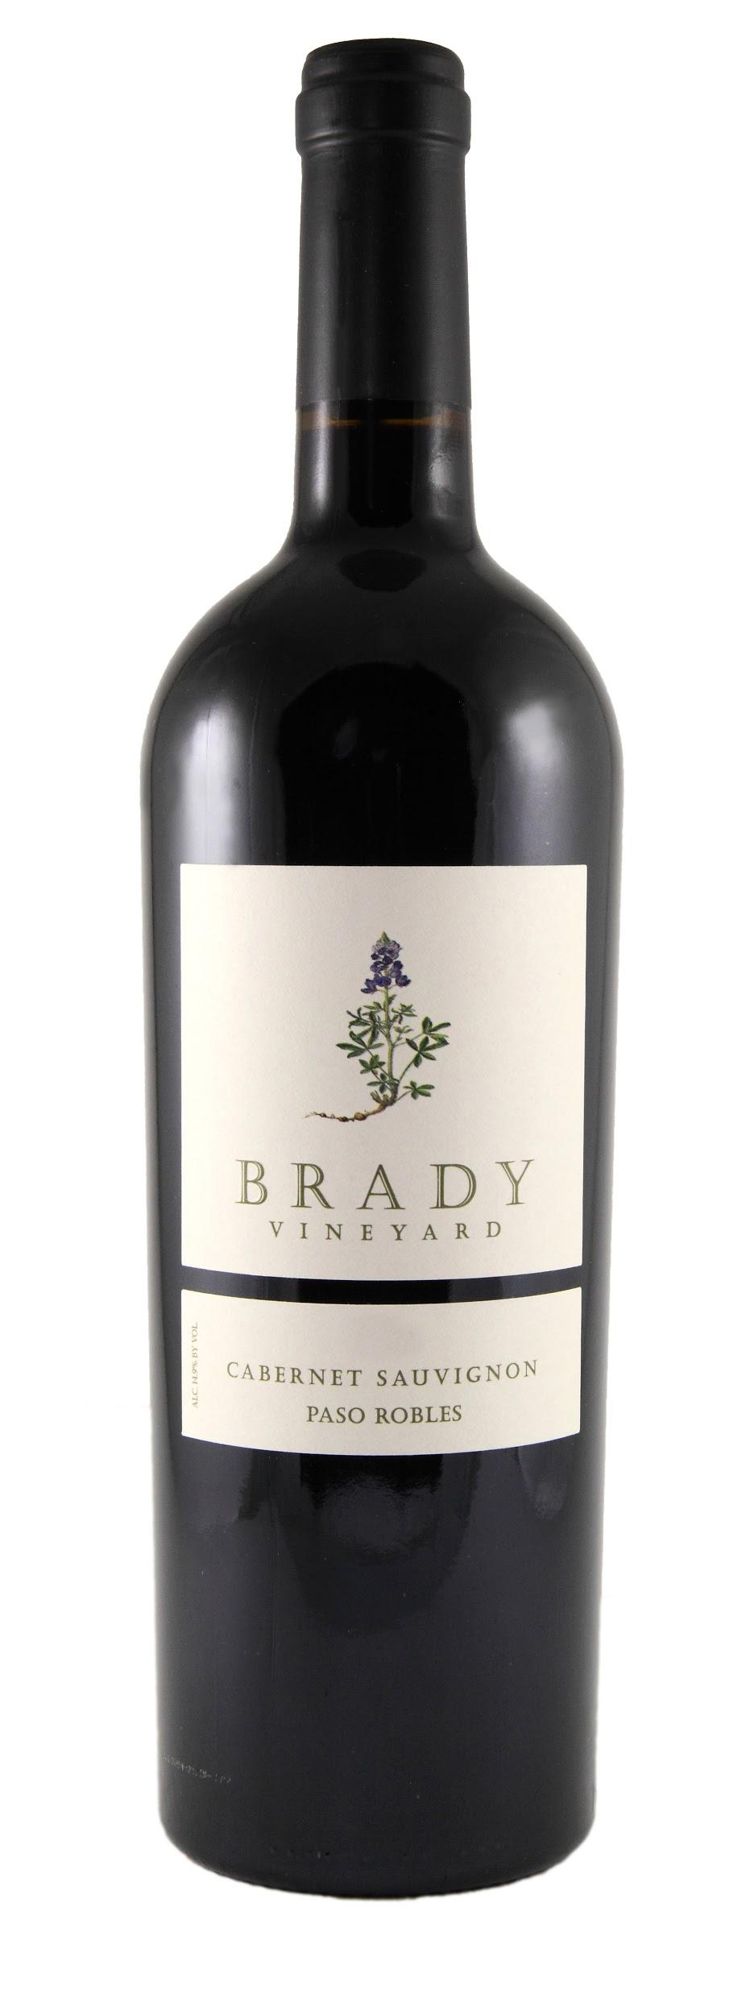
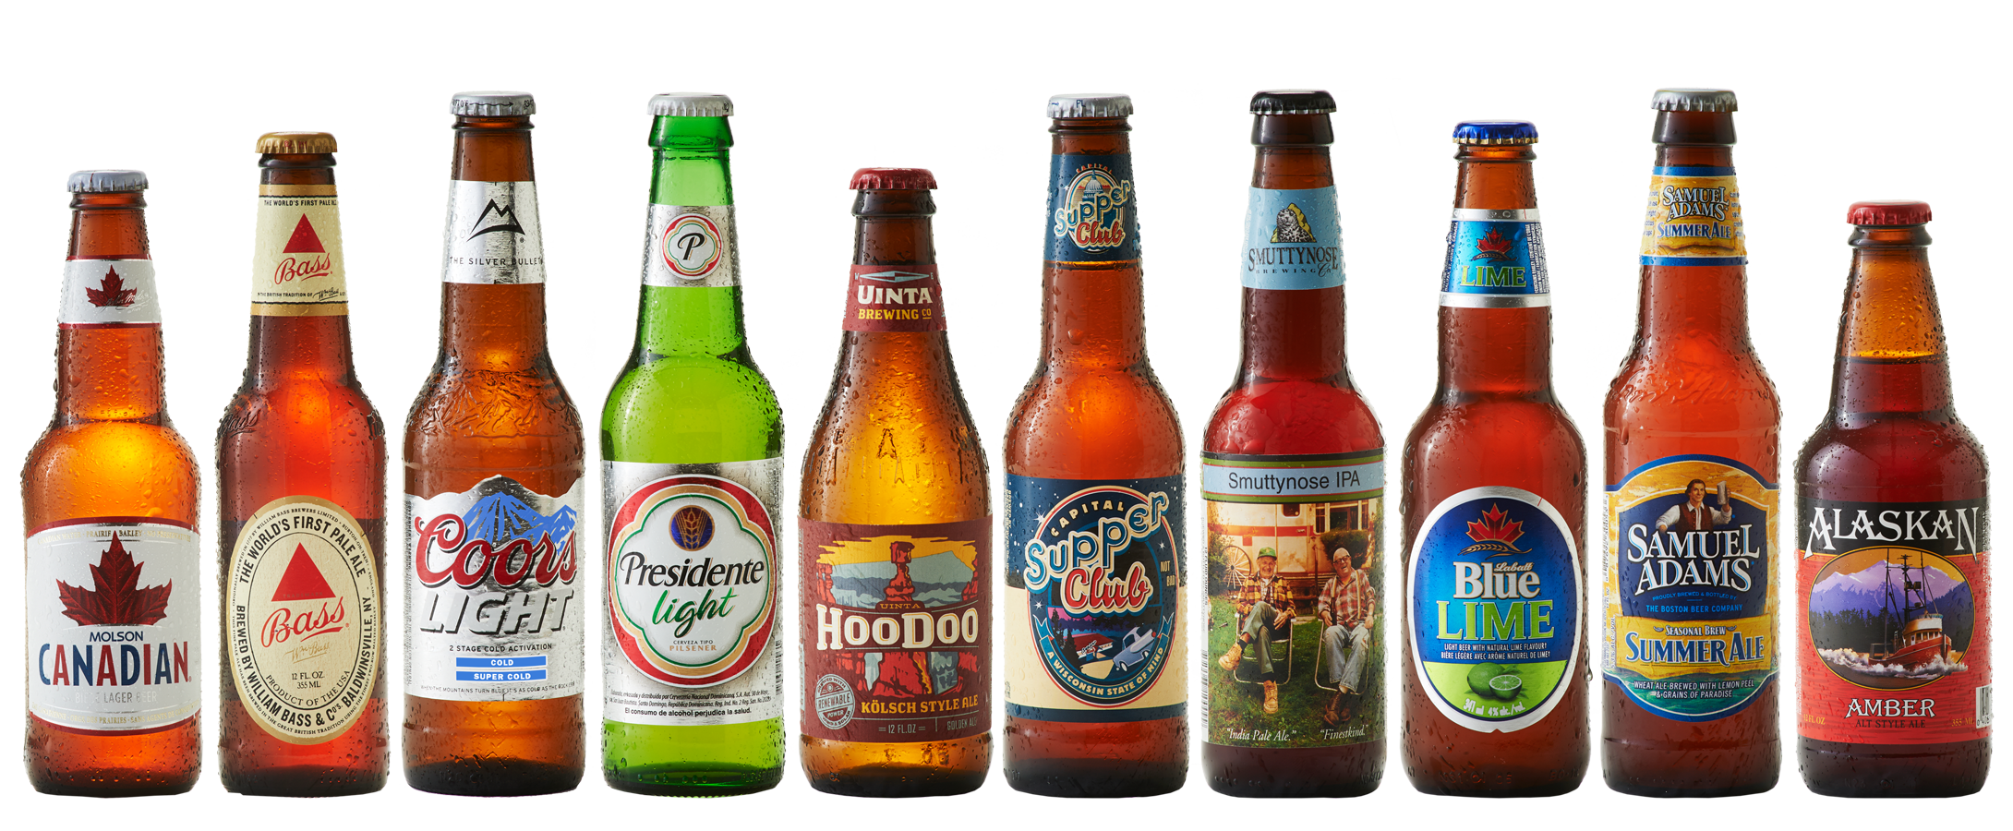
Competitive Advantage
Notes:
Niche market - Kegs only! A service that finds you kegs from other stores and allows you to reserve them
There are quite a few online liquor stores that do sell liquor, wine, and beer
We are only involved with finding kegs online, thus narrowing the market to only such websites

Slide 8
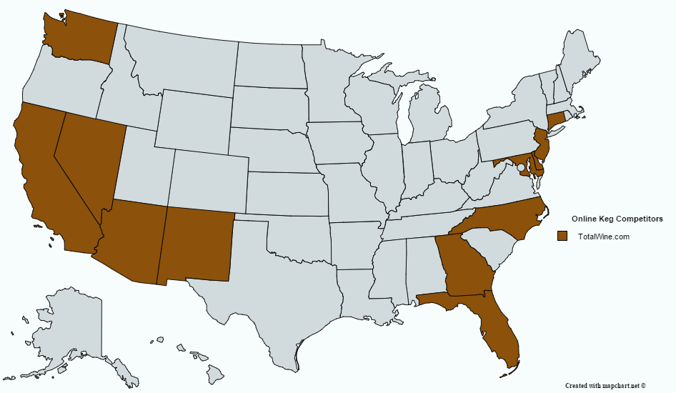
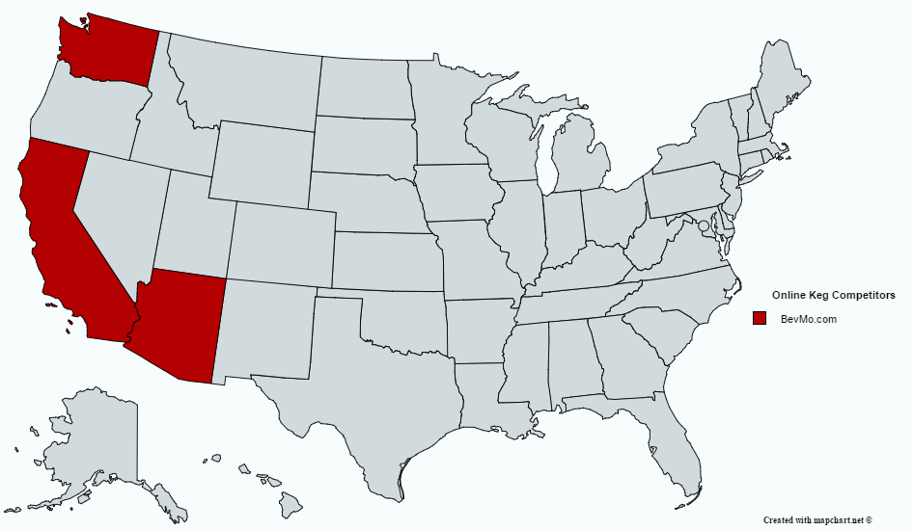
Competitive Advantage
TotalWine.com
BevMo.com
Notes:
The function of our app allows us to be present in any state that has liquor stores
TotalWine.com, BevMo.com, other online liquor stores have presence in a set number of states
Our app asks for a buyer’s current location before choosing keg specs, and then returns closest liquor stores
Potential competitors would even benefit from being located on our app
Our app can create competition between online liquor stores and in-store liquor retailers as well
Another advertising avenue for them
Competition created is beneficial for us
State presence data gathered from sources: https://en.wikipedia.org/wiki/Total_Wine_%26_More
https://en.wikipedia.org/wiki/BevMo!

Slide 9
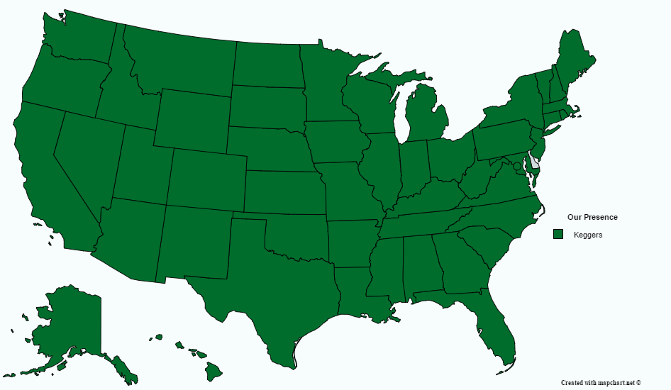
Competitive Advantage
Notes:
The function of our app allows us to be present in any state that has liquor stores
TotalWine.com, BevMo.com, other online liquor stores have presence in a set number of states
Our app asks for a buyer’s current location before choosing keg specs, and then returns closest liquor stores
Potential competitors would even benefit from being located on our app
Our app can create competition between online liquor stores and in-store liquor retailers as well
Another advertising avenue for them
Competition created is beneficial for us
State presence data gathered from sources: https://en.wikipedia.org/wiki/Total_Wine_%26_More
https://en.wikipedia.org/wiki/BevMo!

Slide 10

Risk Analysis and Business Challenges
General Enterprise Business Risks
Because our business lacks a storefront and doesn’t have an inventory, we are not subject to the same risks that some of our competitors might have.
Risk Immunities
No Distribution Management
No need for product Quality Control
Inventory Management
Risks
Marketing/Promotion failure
Acts of Nature
Unreliable partner inventory
Communication Issues With Partners

Slide 11

Risk Analysis Cont.
Industry Specific Risks
This industry is saturated with different players requesting location and inventory based information from liquor stores. Store owners have become suspicious and less trusting
Insufficient number of participating liquor store owners
Partnering with stores that maintain poor or unreliable inventory management
Joint Credibility with partners
Risk Management
Low annual participation cost for liquor stores along with free trials to demonstrate our service value
Maintaining Credibility with our customers hinges on our ability to maintain accurate inventory information.
We will keep track of each unsuccessful reservationS and provide details to the store owners to make them aware of their loss in business. This is in hopes that they will address the issue.

Slide 12

Risk Analysis Cont.
Company Specific Risks
We will provide users of the site/app with a large amount of the information that they seek, prior to any transaction.
They may simply use our site to view nearby liquor stores with their product and leave without a purchase
Risk Management
We plan to recoup some of the losses from customers who decide not to complete their reservations on our site with the revenue received from participating stores that pay the annual fee.
Because the annual fee will be low, we will need to develop a network of liquor stores as quickly as possible.
free trial period

Slide 13
Timeline of Project and Technological Challenges
Business Assessment (1 year - 10 months before opening)
Strengths and weaknesses, costs (Web hosting, fees, offices, etc.), financial resources (personal credit assessment, funding)
Background Research (10 - 7 months before opening)
Licenses, registrations, and/or legal requirements, Insurance and tax policies, Attorney and accountant consultations
Build Infrastructure (7 - 4 months before opening)
Design app and website, front, back-end development, software for both business and users
Marketing and Finishing Touches (4 - 1 months before opening)
Marketing campaign, advertisements, hire/train employees, open

Slide 14
Timeline of Project and Technological Challenges
Information Security/Privacy
Communication
Data Management/Loss
Efficient Website/App
Proper/Updated Hardware

